Slide 1

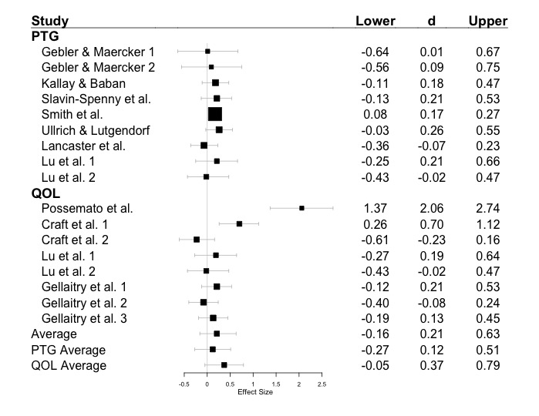
A Meta-Analysis of Expressive Writing on Quality of Life and Posttraumatic Growth
Jeff Pavlacic, Nicholas Maxwell
Faculty Advisor: Dr. Erin Buchanan
Missouri State University
Ψ
Department
of Psychology
Abstract
Pennebaker (1997) suggests that expressive writing can reduce psychological distress associated with a traumatic event. The goal of this particular meta-analysis was to analyze the effectiveness of expressive writing on Posttraumatic Growth (PTG) and Quality of Life (QOL). Articles for the analyses were collected using Psych Info and Google Scholar with specified search terms. Estimated effect sizes were calculated using traditional meta-analysis techniques via fixed and random-effects models in R. Heterogeneity and power of studies were also calculated. Results suggest a small but consistent overall effect size for the effect of expressive writing on both QOL and PTG as well as low power and high heterogeneity between studies. Additional research is necessary in order to discover the effectiveness of expressive writing on PTG and QOL, as the few studies found published were found to be underpowered to detect significant changes in outcomes from expressive writing.
Method
Participants
Ns in collected studies ranged from n = 9 to n = 139.
Participants in collected studies journaled about a traumatic event that particular individual had experienced. These participants had different diagnoses.
Data Collection
Studies were collected through PsychINFO and Google Scholar using the following search terms: Posttraumatic Growth Expressive Writing, Expressive Writing Posttraumatic Growth, PTG Expressive Writing, Expressive Writing PTG, Quality of Life Expressive Writing, Expressive Writing Quality of Life, QOL Expressive Writing, Expressive Writing QOL, Expressive Writing.
Change in PTG and QOL from pre to post-test was the dependent variable of interest.
Only participants assigned to the expressive writing (experimental) group were examined.
If participants received multiple assessments throughout the course of the study, then measurements were examined sequentially (time 1 to time 2, time 2 to time 3).
Cohen’s d effect sizes and confidence intervals were calculated in R using various packages.
Discussion
A small, nonsignificant effect was found using meta-analytic techniques.
Due to the small number of studies available meeting our criterion, additional studies would be useful to assess whether or not an expressive writing intervention using Pennebaker’s paradigm is effective for PTG and QOL.
Limitations:
When power was calculated based on a population estimate of effect size, all studies were severely underpowered to detect differences in groups.
This could be attributed to a limited number of qualified participants, attrition, or misconceptions regarding power and sample size planning (Bakker, Hartgerink, Wicherts, & van der Maas, 2016).
Future Directions:
Moving forward, researchers should carefully consider power. Furthermore, we encourage reporting power analyses of studies for a better understanding of replication and reproducibility (Button et al., 2013).
Additionally, few studies met the criterion of utilizing an expressive writing intervention to determine effectiveness on both PTG and QOL. Additional studies need to be conducted with enough power to detect effects between groups in order to determine the effectiveness/efficacy of expressive writing on these outcome variables.
Introduction
Inhibitory theory discusses how repressing negative emotions can be detrimental to both physical and psychological health (Pennebaker, 1989; Pennebaker & Beall, 1986).
Psychological dysfunction can have detrimental effects on life quality, including everyday habits such as low activity level and inability to progress after a traumatic event.
Therefore, it is imperative to identify ways to effectively express emotion. One of these ways is expressive writing.
PTG is identified as a positive experience after a traumatic event (Yilmaz & Zara, 2016).
QOL is measured by examining an individual’s attitude towards their situation (Costanza et al., 2007).
Different studies have found contradictory results for the effectiveness/efficacy of expressive writing (Lancaster, Klein, & Heifner, 2015). Thus, it is important to understand the effectiveness of expressive writing interventions for traumatic events on different outcome variables (PTG and QOL).
Purpose of Study
The purpose of this study is to conduct a meta-analysis examining the effectiveness of expressive writing on both QOL and PTG and to determine the power of selected studies.
An additional purpose of this study is to shed light on the research necessary to examine the effectiveness of expressive writing on specific positive outcome variables.
Hypothesis
Expressive writing on both QOL and PTG will produce a small effect size.
Results
Removal of outlier (Possemato et al.) eliminated the heterogeneity effect, Q(15) = 17.13, p = .31, I² = 0.0%, 95%CI [0.0%; 25.2%].
Average power for individual study calculations was M = .26 (SD = .29), and the average power for overall effect calculations, d = .13, was M = .12 (SD = .06). Only two individual studies showed an appropriate level of power to detect their effects.
References
Bakker, M., Hartgerink, C. H. J., Wicherts, J. M., & van der Maas, H. L. J. (2016). Researchers’ intuitions
about power in psychological research. Psychological Science, 27(8), 1069–1077.
https://doi.org/10.1177/0956797616647519
Button, K. S., Ioannidis, J. P. A., Mokrysz, C., Nosek, B. A., Flint, J., Robinson, E. S. J., & Munafò, M. R.
(2013). Power failure: why small sample size undermines the reliability of neuroscience. Nature
Reviews Neuroscience, 14(5), 365–376. https://doi.org/10.1038/nrn3475
Costanza, R., Fisher, B., Ali, S., Beer, C., Bond, L., Boumans, R., … Snapp, R. (2007). Quality of life: An
approach integrating opportunities, human needs, and subjective well-being. Ecological Economics,
61(2–3), 267–276. https://doi.org/10.1016/j.ecolecon.2006.02.023
Lancaster, S. L., Klein, K. P., & Heifner, A. (2015). The validity of self-reported growth after expressive
writing. Traumatology, 21(4), 293–298. https://doi.org/10.1037/trm0000052
Pennebaker, J. W. (1997). Writing about emotional experiences as a therapeutic process. Psychological
Science, 8(3), 162–166. https://doi.org/10.1111/j.1467-9280.1997.tb00403.x
Pennebaker, J. W. (1989). Confession, inhibition, and disease. In Advances in Experimental Social
Psychology (Vol. 22, pp.. 211–244). Elsevier. https://doi.org/10.1016/S0065-2601(08)60309-3
Pennebaker, J. W., & Beall, S. K. (1986). Confronting a traumatic event: Toward an understanding of
inhibition and disease.. Journal of Abnormal Psychology, 95(3), 274–281.
https://doi.org/10.1037//0021-843X.95.3.274
Yilmaz, M., & Zara, A. (2016). Traumatic loss and posttraumatic growth: the effect of traumatic loss
related factors on posttraumatic growth. Anatolian Journal of Psychiatry,17(1), 5–11.
https://doi.org/10.5455/apd.188311
For more information, contact Jeff Pavlacic at Pavlacic16@live.missouristate.edu

